Slide 1
Financial Education and Adulting skills for Teens & Young Adults

Slide 2
Instructor
Marie Bonville, MPA
Sunlight Armour Homes, LLC
Education Program Manger
Director of Training, Seminole Tribe of Florida
Owner of Sunlight Armour Homes, LLC
Training
Real Estate
Residential Remodeling

Slide 3
The Goals
The ability to understand how money works
How we earn it: Income
How we spend it: Debt
How we save it: Banking Skills
How we manage/leverage it: Credit
How we protect it: Identity Theft
How we use it to make large purchases: College, Cars, homes

Slide 4
The Purpose

Slide 6
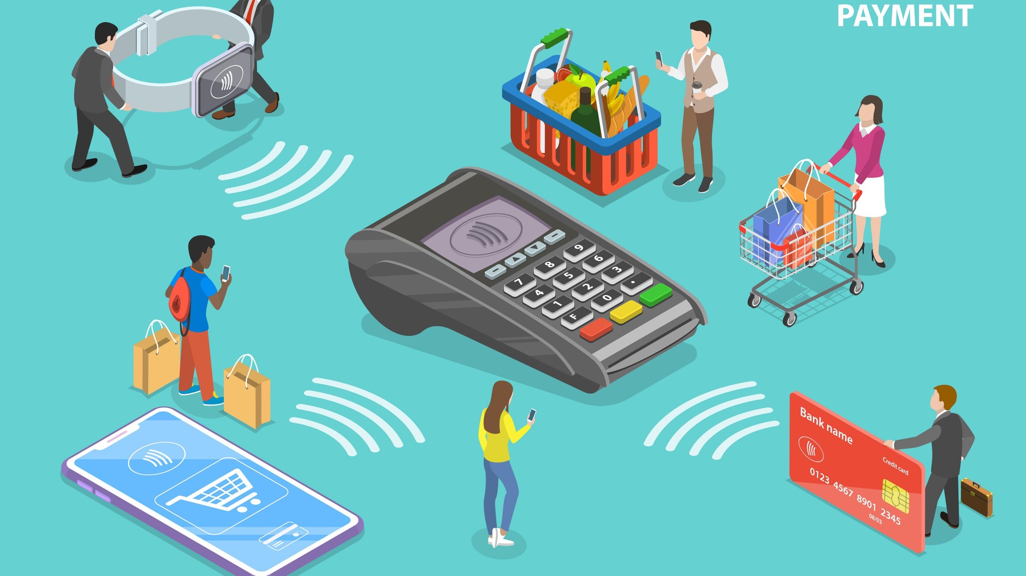
Your Money Personality

Slide 7
Elders, Parents, Family, Friends…
Does your family discuss money?
How did your parents handle money?
What money habits do you have now that you can trace back to an outside influence?

Slide 8
Making The Right Choices Can Save You Money But We Have to Beware Of …

Slide 9
In App Purchases
Fortnite has made $1 billion from in-game revenue since the game launched, according to a report from SuperData Research.

Slide 10
Marketing & Influencers

Slide 11
How Do You Spend Your Money?
What is your favorite item you have ever purchased and why?
What is the 1st large purchase you want to make when you turned 18?
Or
What is the 1st large purchase you made when you turned 18?

Slide 12
Making Good Money Decisions Can Be Hard…
It's estimated that the average adult makes about 35,000 remotely conscious decisions each day.
Somethings like brushing your teeth or having breakfast are easier to do because you have made them a habit or routine.
Here are some tools that will help you make better Money Habits.

Slide 13
Changing Habits
Start Small
The Brain loves the routine
Preparation
Dust of your piggy bank or wallet
Write It Down
Goal charts, spending plans and other printouts provided
Give yourself time
Creating new habits take time
Get a parent, sibling, or friend to help
Be Flexible
If you make a mistake, it is ok! Adults have a hard time too, Just Ask?

Slide 14
Money Smart Tools
Learn how to create a personal budget or spending plan
Understanding how to use a checking and savings account
Understanding the importance of saving money
The importance of credit
How to prevent and recognize the signs of identity theft

Slide 15
Earning Money
Where Does Money Come From…

Slide 16
Legal Tender
The U.S. Treasury controls the printing of money in the United States.
However, the Federal Reserve Bank has control of the money supply.
Coins and paper money or notes are used as a Legal Representation Of Value and can be exchanged for goods or services.

Slide 17
Income
Chores
Jobs
Dividends
Allowance
Gifts
Investments

Slide 18
The Money We Earn Is Called…Income
Most people make money by going to work, this is just one form of Income.

Slide 19
The Money We Spent Is Called…Expense
When we spend money, each payment or purchase we make is called an Expense.
Name 3 Expenses that you have each month?
Name 6 Expenses that your family makes every month?

Slide 20
Next Steps…
Calculating
Calculating your Income
Identifying
Identifying your Expenses
Examining
Examining your Income vs. Expenses
Creating
Creating Spending Goals
Setting
Setting up a Spending Plan
Notes:
Now that you have clearly identified what you financial goals are, let’s develop a spending plan also referred to as a family spending plan.

Slide 21
What Should I Do With My Income?
Save it…
Spend it…

Slide 22
Needs
Determining what you need versus what you want is a very important money skill.
Food
Water
Shelter
Health

Slide 23
Wants
A Want is something you would like to have but is not necessary to living.
Video Games/Apps
Expensive clothes
Makeup
Technology

Slide 24
Calculating Income
Income:
Allowance $50 per month
Part-Time Job $400 per month
Total GROSS monthly income = $450

Slide 25
Types of Expenses
Your expenses are any purchases or payments you make using your income.
Mortgage/Rent Payment
Bills/Utilities
Food
Transportation
Personal/Medical
Savings
Credit Card Debt
Entertainment
Miscellaneous/Other
Notes:
Housing: Mortgage Payment, electricity, gas/oil/coal, monthly repairs
Food: Groceries, Eating Out, School and Work Lunches
Car: Car payment, fuel, insurance, parking/tolls, vehicle maintenance
Personal/Medical: Cell phone bills, clothing for family and work/school, Laundry
Medical: Doctor/Dental bills, Medication
Finance: Credit cards, bank fees, fees associated with predatory lending check cashing or payday loans
Savings: Savings accounts, investments, emergency fund, down payment fund etc.
Debt: Credit Cards, Loan Payments, Student Loans etc.
Entertainment: Movies, books, Netflix, cable, gym, pow wows or other cultural events/ tournaments where you may spend money
Miscellaneous: Back to school shopping: Education supplies, child care, pets (dog food), gifts, money loaned

Slide 26
Calculating Debts
Debts:
Cell Phone $50
Total monthly debt = $50
Notes:
Housing: Mortgage Payment, electricity, gas/oil/coal, monthly repairs
Food: Groceries, Eating Out, School and Work Lunches
Car: Car payment, fuel, insurance, parking/tolls, vehicle maintenance
Personal/Medical: Cell phone bills, clothing for family and work/school, Laundry
Medical: Doctor/Dental bills, Medication
Finance: Credit cards, bank fees, fees associated with predatory lending check cashing or payday loans
Savings: Savings accounts, investments, emergency fund, down payment fund etc.
Debt: Credit Cards, Loan Payments, Student Loans etc.
Entertainment: Movies, books, Netflix, cable, gym, pow wows or other cultural events/ tournaments where you may spend money
Miscellaneous: Back to school shopping: Education supplies, child care, pets (dog food), gifts, money loaned

Slide 27
Types of Expenses (cont.)
Fixed
Expenses with amounts that don’t change from month to month
Flexible
Expenses with amounts that may change from month to month
Luxury
Expenses that were unnecessary or hand less expensive options
Notes:
Fixed Expenses: Rent/Mortgage Payments, Car Payment, Savings: These monthly costs don’t change month to month (pg. 21)
Flexible Expenses: Groceries, Gas, Credit Cards Payment's. Expenses you can control.
Luxury Expenses: Entertainment costs, gaming, new clothes, Eating out
According to Glamour: Young Americans ages 18 to 29 spend more on food than any other age group—$173 per week—

Slide 28
Setting Goals

Slide 29
Money Math
Never Be Afraid…

Slide 31
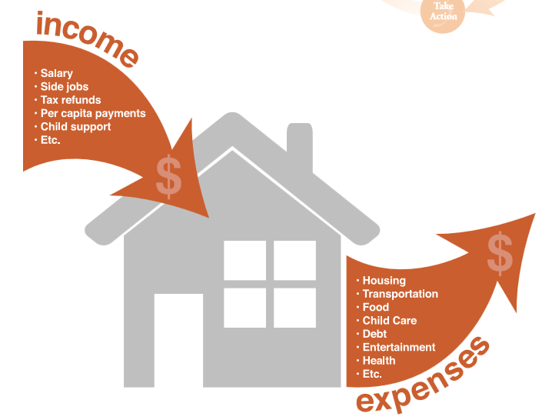
Income vs. Expenses Overview
At the end of the month, break everything down into two categories.
Is your income greater than your expenses?
YES = Great, then you can save.
NO = It’s okay, only with this information can you alter your spending habits and stick to your new budgets

Slide 32
Budgets
Are not set in stone, they should be reviewed often. Adjustments should be made as goals are accomplished and new spending plans replace the old ones.

Slide 33
Setting Your Financial Goals
Short term – less than one (1) year
Mid term – one (1) to three (3) years
Long term – three (3) or more

Slide 34
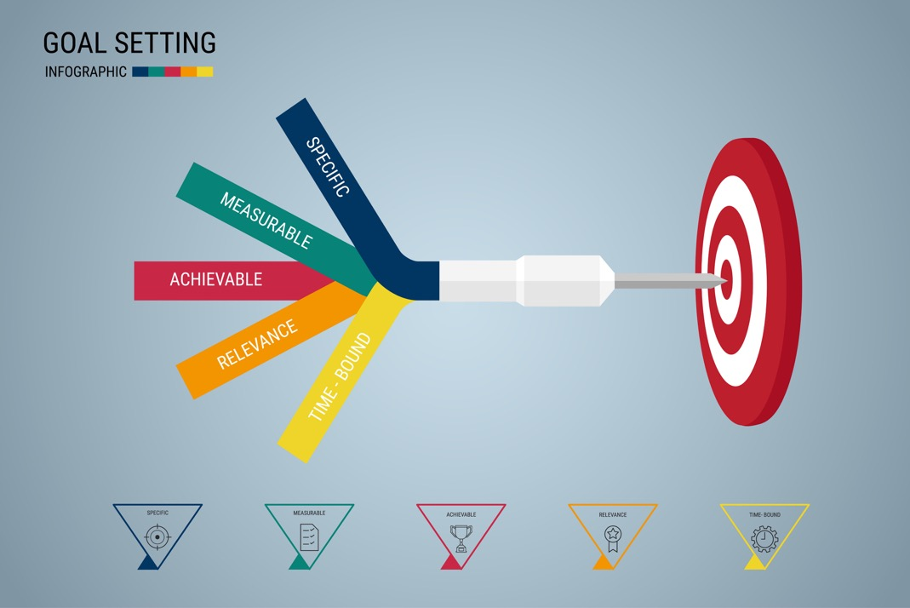
Goals Should Be S. M. A. R. T.
Specific: What is the goal?
Measurable: How much should I save?
Achievable: How long will it take me?
Relevant: Be Realistic
Timely: Can be placed on a calendar.

Slide 35
Planning For Your Money
It is important to plan for how you will save and spend your income; this is called a Budget or Spending Plan.
Your Budget lists all your Expenses, all the items your need to spend money on.
You can make a budget for the day, week, month or year. Let’s take a closer look…

Slide 36
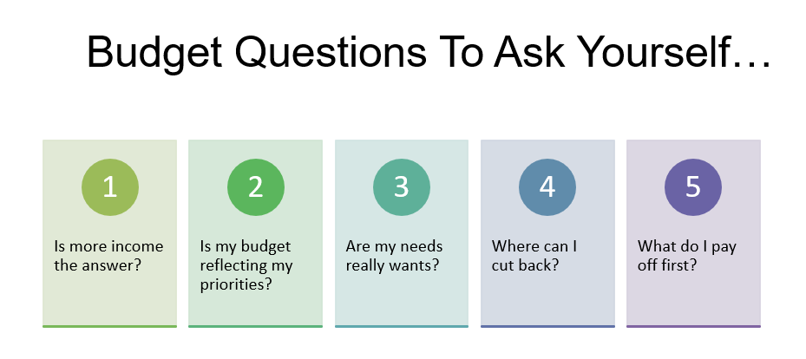
Notes:
Employment Methods: Part Time Job/ Pay Increase
Family Habits: Needs really Wants/Reflection family spending habits and cutting back
Financial: What do I pay off first- Pay more than the minimum, identify high interest loans etc.

Slide 37
What Can Happen If You Walk Around With Cash?

Slide 38
Banking
Why Use a Bank?

Slide 39
Where Does Your Money Live?
Banks
Under the Mattress/Coffee Cans
Your Stuff

Slide 40
Checking Accounts
The money you have earned also known as Income, can be put into a Checking Account, where it can remain safe until you choose to use it.
Putting money in your checking account is called a Deposit.
Taking money out of your checking account is called a Withdrawal.

Slide 41
Checking accounts
Checking accounts allow you to:
Pay bills with debit cards/checks/online bill pay
Get cash, transfer money and make purchases using your debit card
Access your checking account:
At an ATM or bank branch
On your computer (online banking)
On your phone (App) or mobile.

Slide 42
Questions to Ask?
What is the minimum to open an account?
What is the interest rate on the account?
Is there a monthly fee?
Is there any way to avoid monthly fees?
Is there a maximum number of withdrawals/transfers I can make each month?
Is there a fee for using your ATMs? Others?
What is the standard Overdraft Fee? Overdraft Protection Fee?

Slide 43
Saving Accounts
When you set money aside it is called Saving.
At a bank, you can put your money in a Savings Account, where it can be safe. Each month, you should
Bonus: The money the bank gives you for keeping your money at their bank is called Interest.
The Interest earned is Free Money!!!

Slide 44
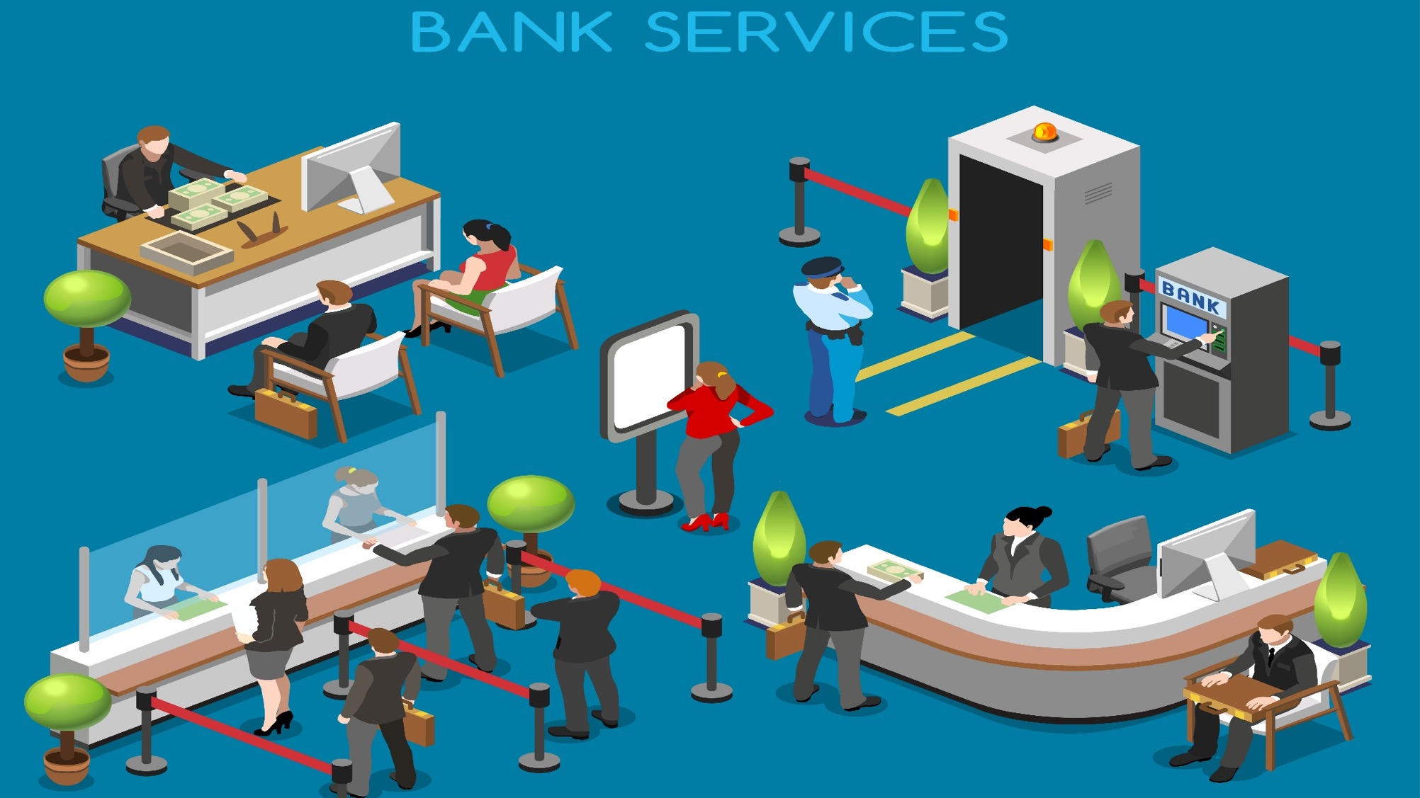
Who Works In The Bank?

Slide 45
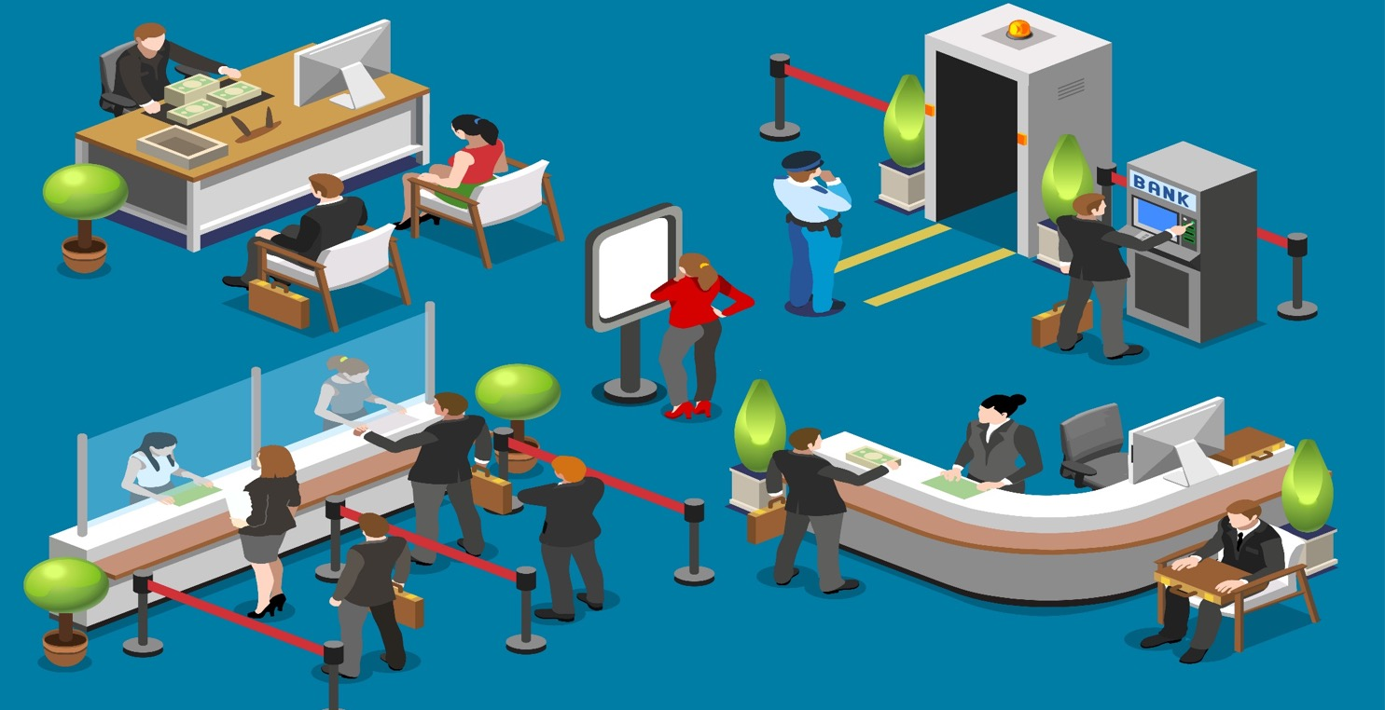
Who Works In The Bank? ATM
ATM

Slide 46
Automated Teller Machine (ATM)
A large computer, the ATM knows how much money you have in your Bank Account.
The ATM allows you to Deposit or make a withdrawal from your account.
The ATM can also tell you how much you have in your account. This amount is called your Account Balance.

Slide 47
Who Works In The Bank?
Security
ATM
Tellers
Customer Service Rep.

Slide 48
Customer Service Representative/Tellers
Helps customers who need to:
Open an Account
Make Deposits
Make Withdrawals
Check their Balance
Speak to a Loan Officer.

Slide 49
Who Works In The Bank?
Security
Loan Officers
ATM
Tellers
Customer Service Rep.

Slide 50
Loan Officers
Speaks to clients about types of Credit and how to apply for a Credit Cards and Loans.

Slide 51
Who Works In The Bank?
Security
Branch Manager
Loan Officer
ATM
Tellers
Customer Service Rep.

Slide 52
Branch Manager
Responsible for overseeing all the bank services and making sure the clients are happy with all the services.
Branch managers also help each section, when there are long lines.

Slide 53
Who Works In The Bank?
Security
Branch Manager
Loan Officer
ATM
Tellers
Customer Service Rep.

Slide 54
Banks Are Businesses
A business has to make money to remain in business.
Like any business banks charge fees for their services.
Lets review Bank Fees.

Slide 55
Debit Cards & Checks
Checks used to be the primary manner of making purchases without using actual money
Deposits in person require deposit slips or you can use direct deposits.
Debit cards are cards that allow you to do the same thing.
Checks and Debit card use should be monitored each month.
This process is called balancing your account.

Slide 56
Writing a Check 101
5/13/19
5/13/15
Mortgage USA
Ford Auto
1200.00
592.89
One Thousand Two Hundred xx/100
Five Hundred Ninety-Two & 89/100
Joe C. Dollar
Acct #: 123456789
Acct #: 321876004
Payment: House Payment
Price: $1200.00
Account Number: 123456789

Slide 57
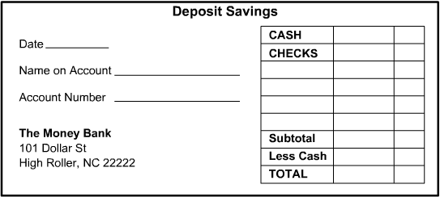
Depositing Money
5/13/19
1200. 00
Joe C. Dollar
123456789
50. 00
1150. 00
Check Amount: $1200.00
Cash Received: $50.00
Total Deposited to Account: $1150.00

Slide 58
Fees
If you earn $30, and buy a video game for $30, you will have 0$ in your account.
Some banks require that you keep a minimum balance, or they will charge a monthly maintenance fee.

Slide 59
Fees
If you earn $30, and buy a video game for $31, you will have Overspent or Overdrawn your account by $1.00.
If you spend more money than you have in your bank account, the bank will charge you a fee.
This is called an Overdraft Fee

Slide 60
Fees
Some banks charge you a fee to open a checking or savings account.
Some banks charge you to replace Debit cards or re-order Checks.

Slide 61
Keep Records
What is a receipt?
Should you keep your receipts?
If you buy something online, do you still get a receipt?

Slide 62
Keeping Records
It is important that you keep a written record of your spending and saving.
Bank’s keep your spending and saving records and give you a copy at the end of each month, this is called a Bank Statement.

Slide 63
Credit Cards

Slide 64
Credit Cards
Banks also offer Credit cards.
So it is very important to protect yourself.
Credit is the ability to purchase goods, services, or retrieve money with a promise to pay it back at a future date and with interest.
Interest is the cost of borrowing money.

Slide 65
Write It Out
Lender’s name: | 1st National Bank of Hollywood
Amount you owe: | $13,224
Term of the loan: | 36 months/3 years
Interest rate & fees: | 5%
Monthly payments: | $396.32
Start by making a list of everything you owe: a credit card balance, student loan, or even money you borrowed from family & friends.
Then total them up. Looking at the numbers can be worrisome, but this is a positive – and necessary – first step to tackling any debt.

Slide 66
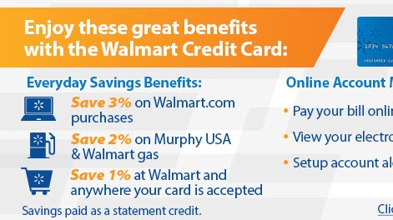
When to Use Credit?
Can you describe a situation when it is a good time to use credit and when it is NOT a good time to use credit?

Slide 67
Things To Look Out For…
Next month’s bills arrive before last month’s bills been paid.
Bills often include late fees if not paid on time.
When any mail arrives open it right away.
Try to keep up with balancing bank accounts.
Try to avoid Late payments and Non-sufficient funds (NSF) appearing on bank statements.

Slide 68
Credit Advantages/Disadvantages
Advantages
Disadvantages
Convenient
Useful for emergencies
Often required to hold a reservation
Ability to purchase expensive items sooner
Eliminates the need to carry large amounts of cash
Paying interest
Additional fees are common
Temptation to overspend
Can cause large amounts of debt
Identity theft

Slide 69
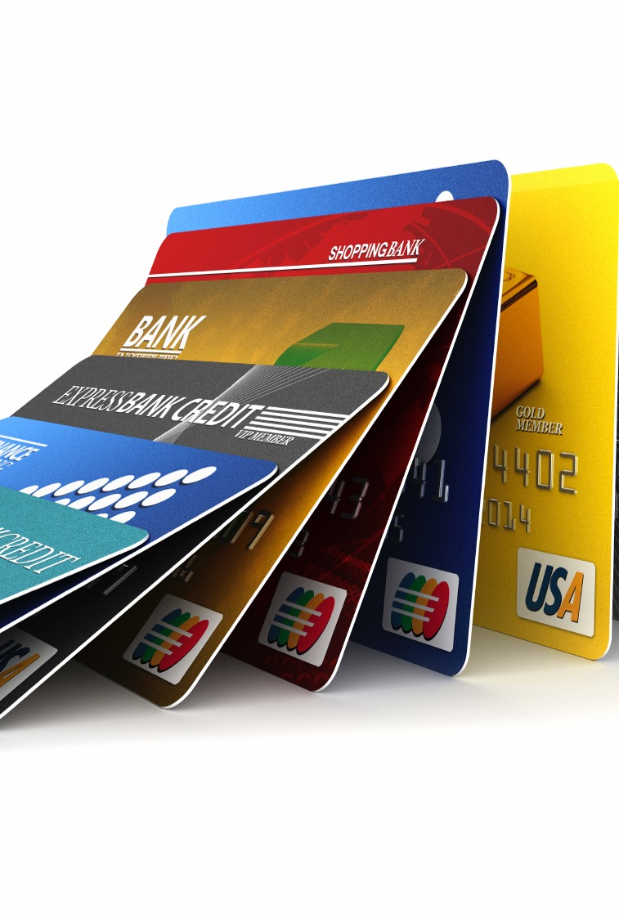
CREDIT CARDS
Credit cards are a great concept but they can bring financial difficulties to people who do not understand the terms and conditions.

Slide 70
Types of Credit Cards: Private Label
Issued by a single source
Can only be used at a single source
Ex. Department Stores/Gas Stations

Slide 71
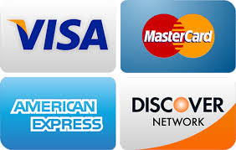
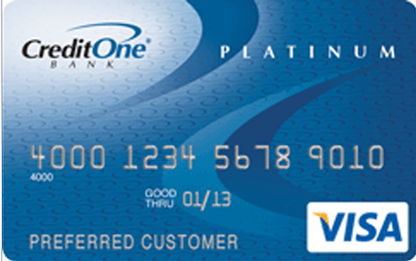
Types of Credit Cards: General Label
Issued by a single source
Can be used in many places
Ex. Banking Institutions & Major Credit Card Providers

Slide 72
There are three types of credit accounts:
Revolving
Installment
Open

Slide 73
Types of Credit
There are three types of credit accounts: revolving, installment and open.
One of the most common types of credit accounts, revolving credit is a line of credit that you can borrow from freely but that has a cap, known as a credit limit, on how much can be used at any given time.
Installment credit refers to loan for a set amount of money with a fixed, regularly occurring repayment schedule
Open credit refers to accounts that you can borrow from up to a maximum amount (like a credit card) but which must also be paid back in full each month.
Notes:
- One of the most common types of credit accounts, revolving credit is a line of credit that you can borrow from freely but that has a cap, known as a credit limit, on how much can be used at any given time. It typically refers to credit cards and home equity lines of credit (HELOCs). And it usually requires monthly payments and interest charges if you carry a balance.
-

Slide 74
Annual Fee | Any fee charged on a yearly basis.
Annual Percentage Rate (APR) | The amount of interest on the total loan that will be paid yearly.
Grace Period | The period of time a credit card company gives to pay the new charges without having to pay interest on a new balance.
Finance Charge | The interest owed when entire balance on the credit card is not paid by the due date.
Credit Limit | The maximum amount of credit that a financial institution/lender will extend to the borrower to use on the credit card.
Card Incentives | A program offered by credit card companies that offer rewards to the borrower every time the credit card is used. Examples: Airline miles, cash back, points, etc.

Slide 75
Banks provide banking services the general public.
Credit Unions provide services to their members.
Checking account records provide proof that you’ve paid bills and help you keep track of spending
Watch Out for Fees: No Recent Overdraft Fees (Within the last 12 Months)
Interest is the cost of borrowing money

Slide 76
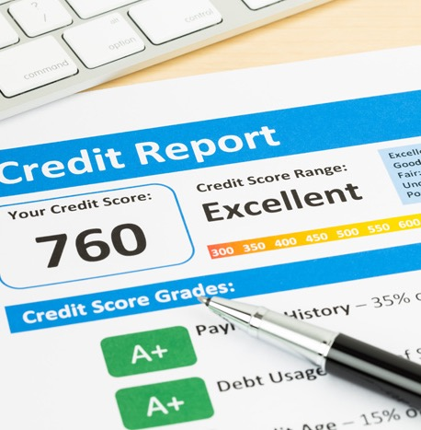
Credit Scores &
Credit Reports

Slide 77
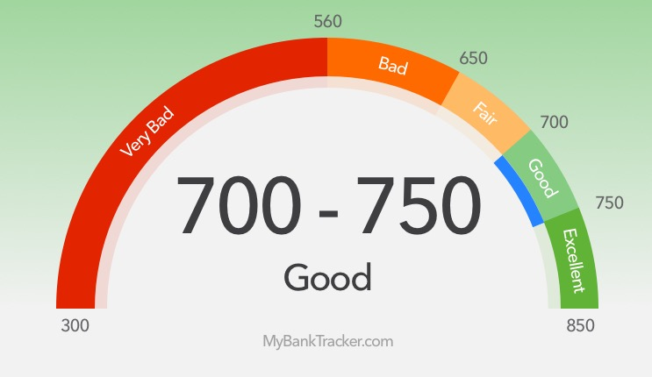
Credit Scores
A prediction of how likely you are to pay your bills
A number between 300 and 850 derived from many different factors
A number that drives the approval of credit extensions and the interest rate you pay on those extensions

Slide 78
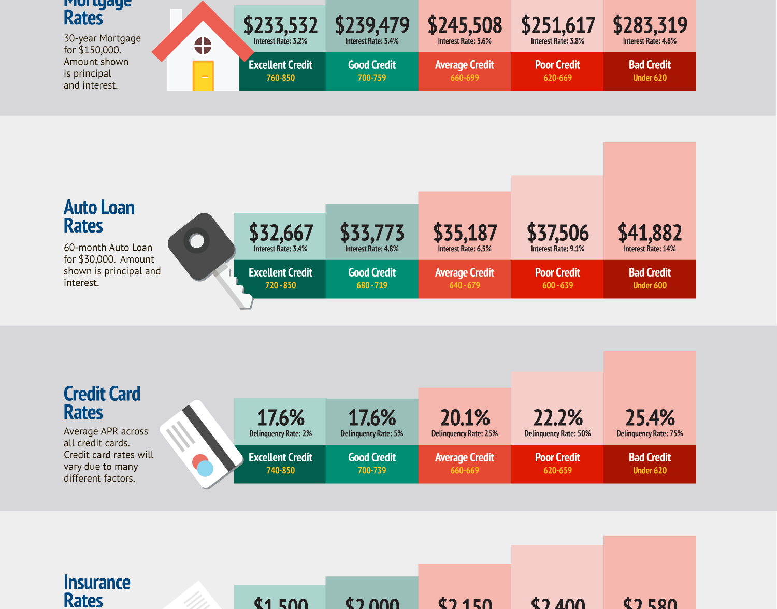
Who is FICO®?
FICO, originally Fair, Isaac and Company, is a data analytics company based in San Jose, California focused on credit scoring services. It was founded by Bill Fair and Earl Isaac in 1956.
Mortgage rates
Auto loans rates
Credit card rates
Insurance rates
So much more...
Notes:
.
FICO, originally Fair, Isaac and Company, is a data analytics company based in San Jose, California focused on credit scoring services. It was founded by Bill Fair and Earl Isaac in 1956. Its FICO score, a measure of consumer credit risk, has become a fixture of consumer lending in the United States.

Slide 79
5 C’s of Credit
Character: Credit history
Collateral: Personal valuables to guarantee repayment
Capacity: Repayment sources
Conditions: Situations that affect repayment
Capital: Personal investment (down-payment) and alternative repayment sources

Slide 80
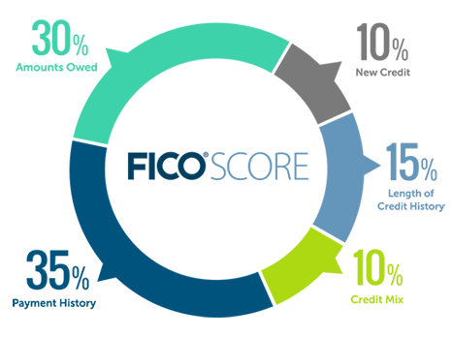
The Breakdown
How you pay your bills (35%)
Amount of money you owe and the amount of available credit (30%)
Length of credit history (15%)
Mix of credit (10%)
New credit applications (10%)

Slide 81
Range of Credit Scores
The following are some basic guidelines for interpreting a credit score:
Range: | Interpretation:
620 and below | Poor Credit
621-690 | Fair Credit
691-720 | Good Credit
721-750 | Good to Excellent Credit
751 and above | Excellent Credit

Slide 82
Who Are The Major Credit Reporting Agencies?
Experian = Most well known in the United States as a one of the three largest consumer credit reporting agencies
Transunion = Provides credit information and information management services to approximately 45,000 businesses and approximately 500 million consumer worldwide in 33 countries.
Equifax = Information that Equifax collects, and is required by law to provide to consumers annually, is included as part of the free credit report

Slide 83
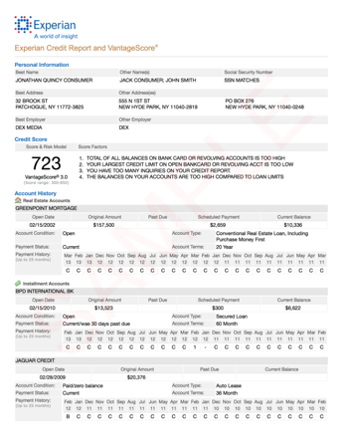
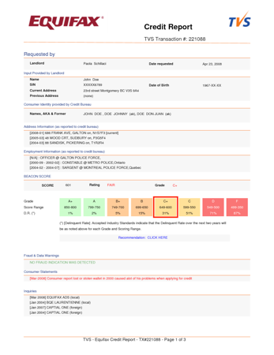
Sample Credit Report
PDF

Slide 84
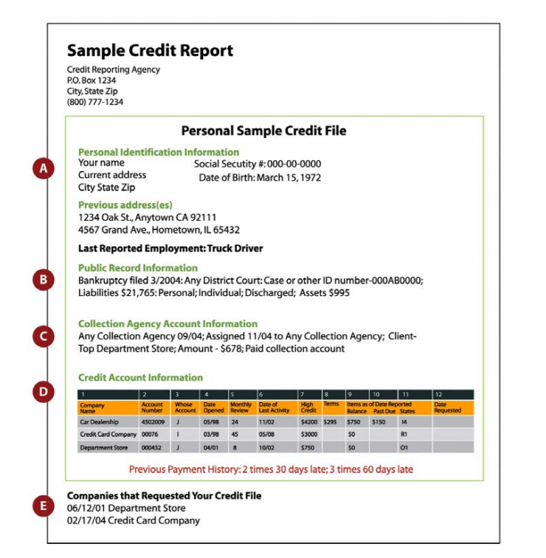
Look out for anything Negative…
Mistakes
Personal Information
Summary of Accounts
Account History
Public Information
Inquiries
Creditor Contacts
Late payments Collections
Tax liens
Judgments

Slide 85
What Actions Will Hurt My Credit Score?
Missing payments, regardless of $ amounts. It takes 24 months to restore credit with 1 late payment. A consumer should anticipate about a 60 – 70 point drop in their credit score with 1 late payment. (over 30-days)
Credit cards at capacity/limits.
Closing credit cards out.
Shopping for credit excessively.
Opening numerous trade lines in a short period of time.
Having more revolving credit compared to installment type loans.
Borrowing from finance companies.

Slide 86
Pulling Your Credit
Pull your free credit report at https://www.annualcreditreport.com/index.action
You will have the option to pull: Transunion, Experian, and/or Equifax
If you are trying to purchase a home or trying to clean up your credit… Pull all 3. If not, just pull one at a time throughout the year to keep an eye out for anything negative.

Slide 87
Make a list
Late payments over 30 days
Negative unpaid credit
Tackle Issues from Smallest to Largest
Interest
Amount

Slide 88
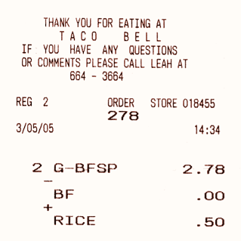
Keep Your Receipts
Keep receipts of payment!
Creditors could forget to take it off your credit report.
If they do, you will have to provide proof of payment.

Slide 89
Dispute It.
If you believe you have found an error, you can dispute it by contacting each credit bureau where the debt appears.

Slide 90
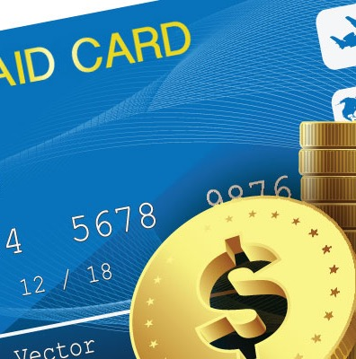
Credit Accounts
If you have credit cards:
Keep credit cards and lines of credit balances under 30% of your credit card limit.
All close to or over the limit credit lines bring down your credit score.

Slide 91
Applying for credit
Don’t have too many companies pull your credit.
That can bring your score down.

Slide 92
Credit Report Record History
How long does derogatory credit remain on your credit report?
Bankruptcy
– up to 10 years.
Law Suits, Paid Tax Liens, Criminal Records
– up to 7 years.
Inquiries may stay present on your credit report for up to 2 years.

Slide 93
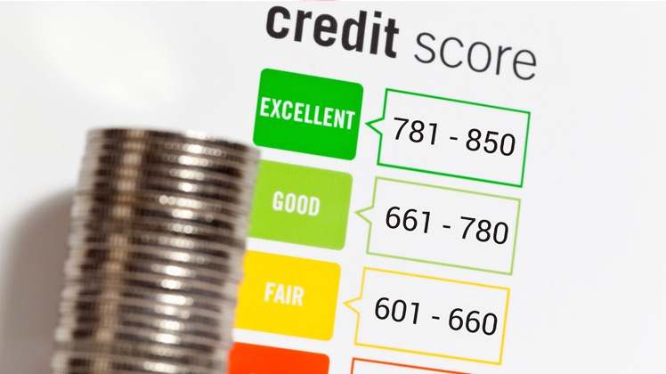
Improving Your Credit Score
Pay bills on time
Get current and stay current
Don’t open a lot of new accounts too fast
Correct mistakes
Shop for loan rates within a focused period of time
Keep balances low on revolving credit
Pay off debt
Check your credit report

Slide 94
Homework:
Find and review your bank/credit card statements?
Look for fixed, flexible, and Luxury Spending
Look for fees
Calculate your monthly Income, Debts

Slide 95
Thank You.

