Slide 1
OWNING A Home and other adulting skills

Slide 2
The Goals
The ability to understand how money works
How we earn it: Income
How we spend it: Debt
How we save it: Banking Skills
How we manage/leverage it: Credit
How we protect it: Identity Theft
How we use it to make large purchases: College, Cars, homes

Slide 3
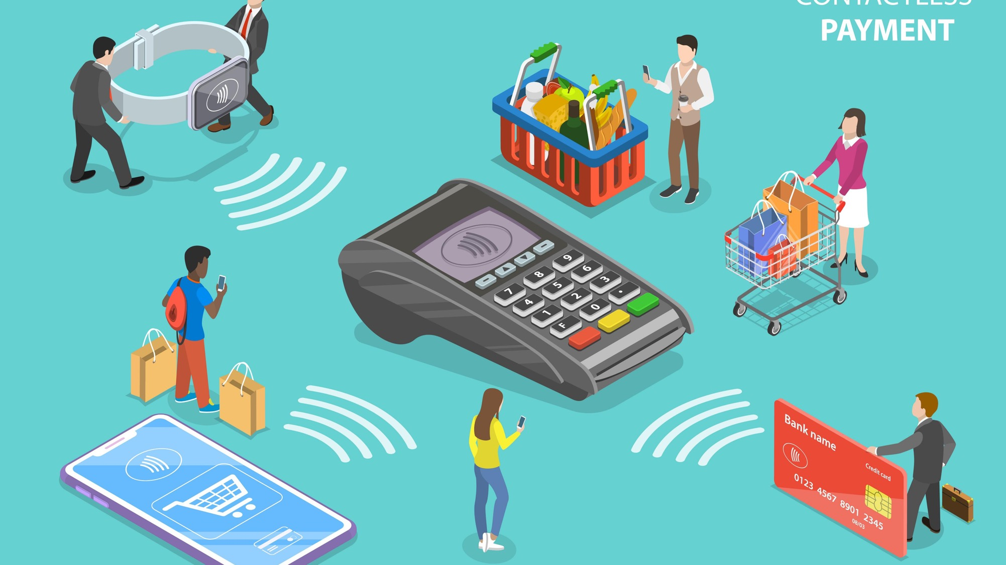
Your Money Personality

Slide 4
Marketing & Influencers

Slide 5
Making Good Money Decisions Can Be Hard…
It's estimated that the average adult makes about 35,000 remotely conscious decisions each day.
Somethings like brushing your teeth or having breakfast are easier to do because you have made them a habit or routine.
Here are some tools that will help you make better Money Habits.

Slide 6
Changing Habits
Start Small
The Brain loves the routine
Preparation
Dust of your piggy bank or wallet
Write It Down
Goal charts, spending plans and other printouts provided
Give yourself time
Creating new habits take time
Get a parent, sibling, or friend to help
Be Flexible
If you make a mistake, it is ok! Adults have a hard time too, Just Ask?

Slide 7
Homework:
Find and review your bank/credit card statements?
Look for fixed, flexible, and Luxury Spending
Look for fees
Calculate your monthly Income, Debts

Slide 8
Money Smart Tools
Learn how to create a personal budget or spending plan
Understanding how to use a checking and savings account
Understanding the importance of saving money
The importance of credit
How to prevent and recognize the signs of identity theft

Slide 9
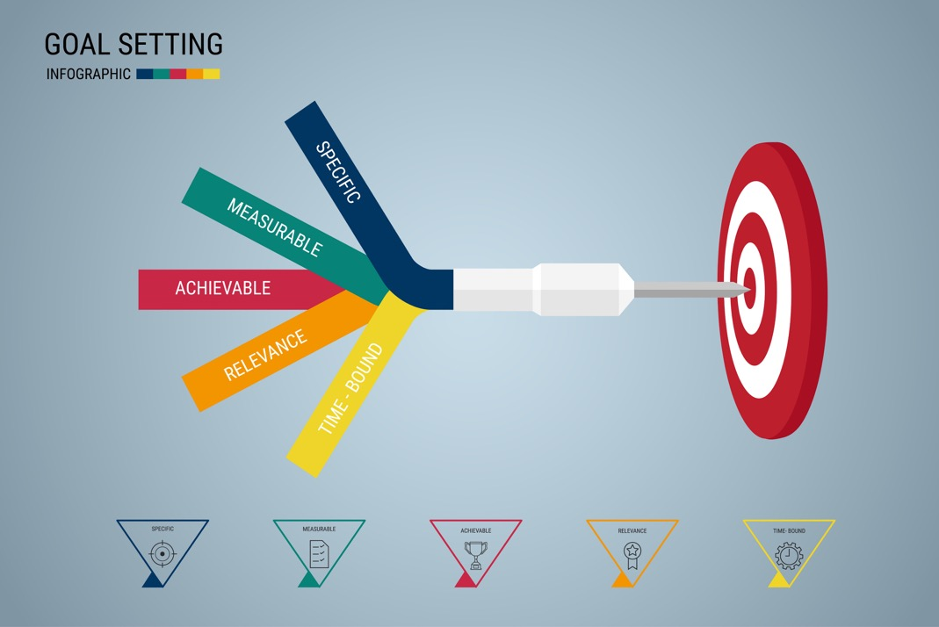
Goals Should Be S. M. A. R. T.
Specific: what is the goal?
Measurable: How much should I save?
Achievable: How long will it take me?
Relevant: Be Realistic
Timely: Can be placed on a calendar.

Slide 10
Banks Are Businesses
A business has to make money to remain in business.
Like any business banks charge fees for their services.

Slide 11
Credit Cards

Slide 12
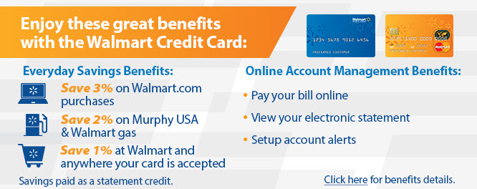
When to Use Credit?
Can you describe a situation when it is a good time to use credit and when it is NOT a good time to use credit?

Slide 13
Credit Advantages/Disadvantages
Advantages
Disadvantages
Convenient
Useful for emergencies
Often required to hold a reservation
Ability to purchase expensive items sooner
Eliminates the need to carry large amounts of cash
Paying interest
Additional fees are common
Temptation to overspend
Can cause large amounts of debt
Identity theft

Slide 14
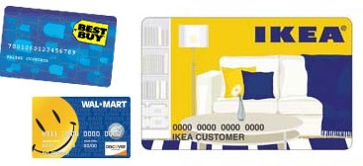
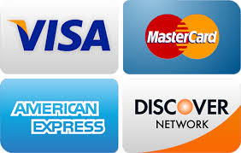
Credit Cards
Private Label
Issued by a single source
Can only be used at a single source
Examples:
Department Stores
Gasoline Companies
General Label
Issued by a single source
Can be used in many places
Examples:
Bank Card
Major Credit Card

Slide 15
Credit Scores
A prediction of how likely you are to pay your bills
A number between 300 and 850 derived from many different factors
A number that drives the approval of credit extensions and the interest rate you pay on those extensions.

Slide 16
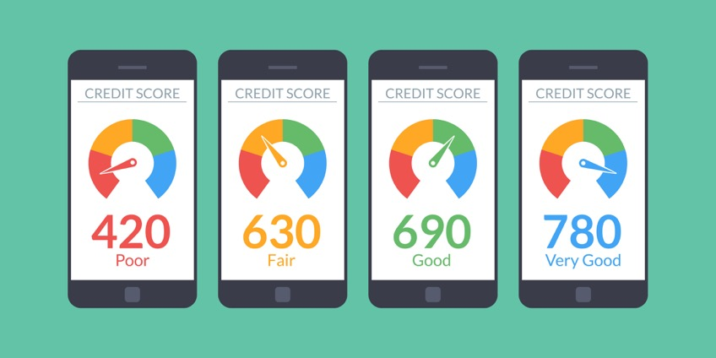
300 TO 850

Slide 17
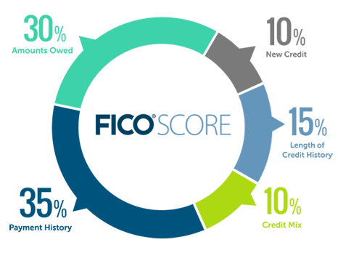
Credit Scores Key Factors
The FICO® scoring model looks at more than 20 factors in five categories:
How you pay your bills (35%)
Amount of money you owe and the amount of available credit (30%)
Length of credit history (15%)
Mix of credit (10%)
New credit applications (10%)

Slide 18
Who Are The Major Credit Reporting Agencies?
Experian = Most well known in the United States as a one of the three largest consumer credit reporting agencies
Transunion = Provides credit information and information management services to approximately 45,000 businesses and approximately 500 million consumer worldwide in 33 countries.
Equifax = Information that Equifax collects, and is required by law to provide to consumers annually, is included as part of the free credit report

Slide 19
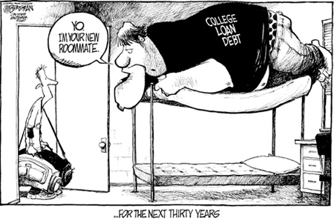
School finances
Paying for School
School Expenses
Apartment Shopping

Slide 20
Fixed and Flexible Costs
Fixed Costs aka the “School Bill”
Tuition and Fees
On Campus vs Apartment Living
Flexible Costs - The “Extras”
Books, Supplies, Meal Plans
Transportation
Living Expenses

Slide 21
5 Types of Student Aid
Grants and scholarships: free money that does not need to be repaid.
Scholarships and grants can be academic, athletic, income-based or sociocultural
Work-study jobs: Part-time student employment jobs which let you earn as you learn.
Work study is based on your family’s income and is filled on a 1st come 1st serve basis
Student loans: Money that is repaid over several years, usually with interest.
Student loans may be taken out by the student or the parent
Education tax benefits: such as the Hope Scholarship tax credit, which is money you get by filing a federal income tax return, even if you don’t owe any taxes.
Military student aid: such as ROTC and the GI Bill, where you earn money for your education in exchange for service in the United States Armed Forces.

Slide 22
Grants and scholarships
Grants and scholarships are better than student loans because you don’t have to pay them back!
Need Based: Some funds are awarded based on financial need (the difference between the costs and ability to pay)
Merit Based: Some funds are based on academic, artistic or athletic merit or other skills and activities
GPA/ACT or SAT score/Class rank/extracurriculars
Some funds are based on “other” criteria
Creating a prom costume out of duct tape
A scholarship for left-handed students

Slide 23
Applying for Aid
FAFSA (Free Application for Federal Student Aid) – www.fafsa.ed.gov
Tribal organizations
Institutional aid applications
Be sure to check each individual school’s website to find out what forms are required and when they must be filed.

Slide 24
Preparation is key
Each year, the federal government awards roughly $150 billion to college students through need-based grants, loans, and work-study funds.
Filing the FAFSA ensures you are in the running.
It is required.
Watch deadlines.
Be organized.

Slide 25
October 1 is the first day that the FAFSA can be completed.

Slide 26
What is Financial Need?
Cost of Attendance
– Expected Family Contribution
= Financial Need

Slide 27
Buying a Vehicle
GOALS
List and explain the steps of the car-buying process.
Explain vehicle financing choices, including leasing.
Discuss consumer protection laws for new- and used-car buyers.

Slide 28
The Car-Buying Process
Identify your needs and wants.
What do I need to do with a car?
How much will I drive?
Do I plan to haul a number of people or gear?
Will I take the car off-road?
What features would I like to have on the vehicle?

Slide 29
The Car-Buying Process
Decide what you can afford.
Monthly payment
No more than 20 percent of the money you have left after paying your regular monthly expenses
Other costs
Maintenance
Fuel
Auto insurance

Slide 30
The Car-Buying Process
Identify and research your choices.
Select several types of cars that would meet your needs.
Research the features of each possibility.
Compare the features of the models you are considering against your list.

Slide 31
The Car-Buying Process
Decide whether to buy new or used.
Cost is a major factor in this decision.
A new car is much more expensive.
A new car loses much of its market value as soon as you drive it off the lot.
Buying a well-maintained used car can save you money.
On the other hand, a used car is likely to need more repairs.

Slide 32
The Car-Buying Process
Decide how you will pay for it.
Find out how much money you will be qualified to borrow before visiting car dealers.
Preapproval is the process of getting a new- or used-car loan prearranged through your bank or credit union.

Slide 33
The Car-Buying Process
Check insurance rates.
Check out the insurance rates on your vehicle choices.
A call to your insurance agent to get this information helps rule out choices that may result in insurance that is too high.

Slide 34
The Car-Buying Process
Search for available vehicles.
Consumer websites
carvana
Test drive each vehicle.
Compare ride, handling, braking, features, and cost.
Try all the features to see how well they work.

Slide 35
The Car-Buying Process
Check the history of a used vehicle.
Enter the VIN into the online search tool at CARFAX to get a detailed history.
A vehicle identification number (VIN) is an alpha-numeric number that identifies each vehicle manufactured or sold in the United States.
The full report provides information such as:
Whether the vehicle has been in a serious accident
How many times the vehicle has been sold
The mileage readings each time it was sold

Slide 36
The Car-Buying Process
Get the vehicle checked mechanically.
Have the vehicle checked out by a mechanic.
You’ll about the condition of the engine.
If the engine is in good shape, ask for a complete check to see what repairs might need to be made in the near future and their cost.
Many states require vehicles to pass a vehicle emissions test, which verifies that a vehicle meets the minimum clean-air standards.

Slide 37
The Car-Buying Process
Determine a fair price.
Decide on a fair price before you make an offer.
Pricing guides
Ads for similar cars
A fair price for a new car usually lies somewhere between the sticker price and invoice price.
For a new car, the sticker price, or manufacturer’s suggested retail price (MSRP), is the price shown on the tag in the car’s window.
The price the dealer paid for it is called the invoice price.

Slide 38
The Car-Buying Process
Negotiate the price.
Make up your mind that you will not be pressured into paying more than you think is fair.
To prevent confusion in determining the true price of the new car, negotiate the price for it separately from the price for your trade-in.
Consider using a car-buying service
A car-buying service allows you to choose the vehicle features you want, and a professional car buyer takes over the price negotiation for you.

Slide 39
The Car-Buying Process
Dealer add-ons
After you have agreed on the price from a vehicle dealership, the dealer may try to increase the purchase price with dealer add-ons.
Dealer add-ons are high-priced, high-profit dealer services that add little or no value.
Examples include:
Dealer preparation
Protective wax or polish
Rustproofing
Extended warranties

Slide 40
Financing Your Car
Financial institutions
Car dealers
Leasing a car

Slide 41
Consumer Protection for Car Buyers
New car warranties
Lemon laws
FTC rule

Slide 42
New Car Warranties
A new-car warranty provides a buyer with some assurance of quality.
Car warranties vary in the time and mileage of the protection they offer and in the parts they cover.
The main aspects of a warranty are the coverage of basic parts against manufacturer defects and the coverage of the power train for the engine, transmission, and drive train.

Slide 43
Lemon Laws
Lemon laws exist in many states and protect consumers from the consequences of buying a defective car.
A lemon is a car with substantial defects that the manufacturer has been unable to fix after repeated attempts.
Lemon laws allow you to get a new car or your money back.

Slide 44
FTC Rule
The Federal Trade Commission’s “Used-Car Rule,” called the FTC Rule, requires that dealers fully disclose to buyers what is and is not covered under warranty for the used vehicle.

Slide 45
Maintaining a Vehicle
GOALS
Identify the costs of owning and operating a car.
Describe methods for extending the life of your car and maintaining its resale value.

Slide 46
Costs of Owning a Car
Fuel
The cost of gasoline depends on world supplies of crude oil, political conditions, and world energy markets.
The amount of gasoline you consume depends on your car’s fuel efficiency, the number of miles you drive, and your driving habits.
A hybrid is a type of vehicle that uses alternate energy sources, such as natural gas or battery power, in addition to gasoline.

Slide 47
Costs of Owning a Car
Depreciation
Depreciation is a decline in the value of property due to normal wear and tear.
Older vehicles called classic cars, which are in excellent condition, may appreciate, or increase in value, if people value them as collectors’ items.

Slide 48
Costs of Owning a Car
Registration and title
A car title is a legal document that establishes ownership of the vehicle.
You must pay title fees and sales taxes only at the time you buy the car.
You must also pay an annual car registration or license tag fee.

Slide 49
Costs of Owning a Car
Vehicle emission fee
In many states, you are required to have your car tested to be sure it is meeting environment standards for vehicle emissions.
Vehicle emission tests are often required every two years once the car is four or more years old.

Slide 50
Costs of Owning a Car
Maintenance and repairs
The owner’s manual will tell you what services your car needs and how often.
You should also plan for unscheduled repairs.
You should expect to replace parts as they wear out.

Slide 51
Costs of Owning a Car
Accessories
Many people choose to add certain features to make their vehicles safer, more functional and attractive, or more efficient.
These items include GPS systems, Bluetooth, DVD players, snow tires, wheel covers, striping and paint features, alarm systems, and sound systems.
In some cases, these accessories will add to the value of the vehicle.
In other cases, they will subtract from it.

Slide 52
Extending the Life of Your Car
Maintain fluid levels
Lubrication, oil change, and oil filter replacement
Other fluids
Perform routine maintenance
Inspect and replace as needed
Use guideline in owner’s manual
Keep your car in a garage
Protects the vehicle from theft and vandalism
Protects the vehicle from weather

Slide 53
Extending the Life of Your Car
Preserve the exterior.
Wash car regularly
Wax the paint twice a year
Once the paint has begun to oxidize (permanently lose its color and shine because of chemical reaction with the air), it is very difficult to restore the original gloss.
Consider a car detail
A car detail is a service provided by specialists who clean and polish the outside, along with cleaning and treating the interior.

Slide 54
Extending the Life of Your Car
Preserve the interior.
Clean and protect the upholstery.
The upholstery is the seat-covering material.
Upholstery choices include cloth, vinyl, and leather.
Clean and protect the carpet.
Use floor mats.
Vacuum regularly.
Use appropriate products to protect vinyl dashboards and plastic interior surfaces.

Slide 55
Extending the Life of Your Car
Follow wise driving habits.
Good driving habits can keep your vehicle running efficiently for years.
Some new vehicles have a “break-in period,” during which you may need to drive differently.

Slide 56
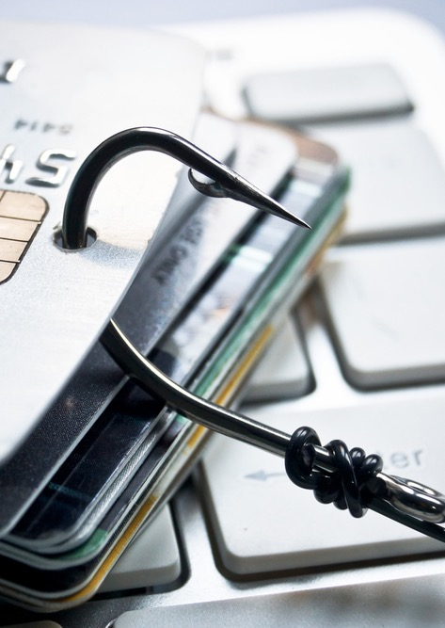
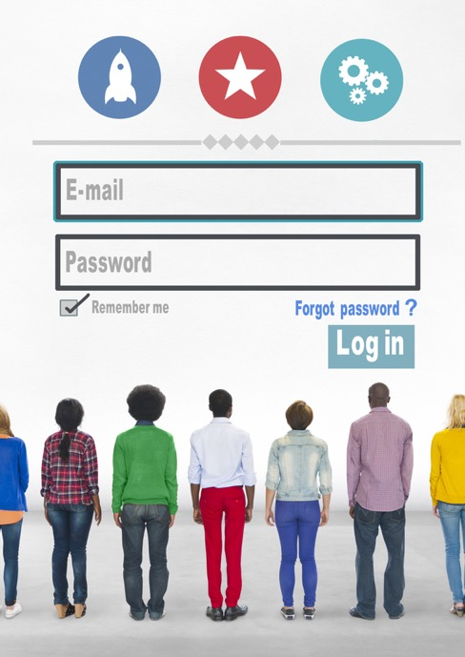
Identity Theft and Fraud Prevention

Slide 57
Could This Happen To You?

Slide 58
Preventing Fraud
Phishing
Digital Wallet
Online Safety
Travel
Retail/ATM

Slide 59
Preventing Fraud
At Home
Mail and Phone Scams
Email
Deceptive Marketing

Slide 60
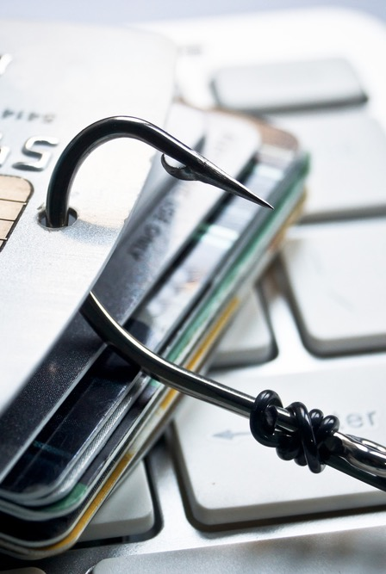
Phishing
What is Phishing?
Phishing is when fraudsters pretend to be from well-known companies, organizations, or government agencies, while asking for personal information.
Notes:
The most common form of phishing is emails pretending to be from a legitimate retailer, bank, organization, or government agency. The sender asks to “confirm” your personal information for some made-up reason: your account is about to be closed, an order for something has been placed in your name, or your information has been lost because of a computer problem. Another tactic phishers use is to say they’re from the fraud departments of well-known companies and ask to verify your information because they suspect you may be a victim of identity theft! In one case, a phisher claimed to be from a state lottery commission and requested people’s banking information to deposit their “winnings” in their accounts.

Slide 61
Phishing Tips
Only open emails, attachments, and links from people you know.
It's easy to steal the colors, logos and header of an established organization and make emails appear legitimate.
Don't reveal personal or financial information in an email, text, or over the phone.
Pay attention to a website's URL. Place your cursor over any links to see where they actually lead.
If you are unsure whether an email request is legitimate, always verify it by contacting the company directly. Report suspected phishing emails to phishing@visa.com or your credit card provider.

Slide 62
Phishing Cont.

Slide 63
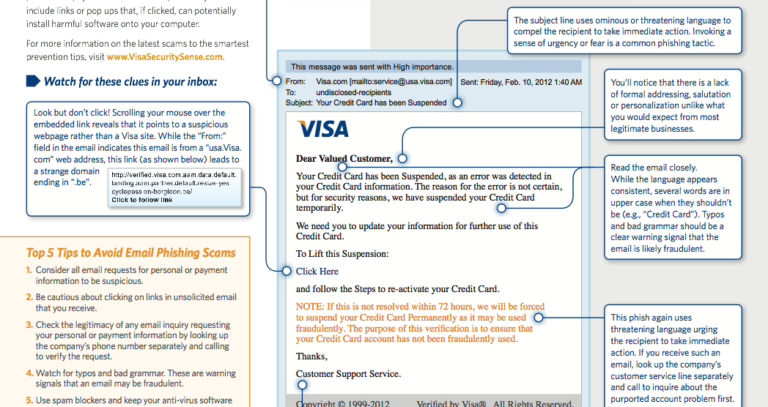

Slide 64
Digital Wallet Services
Digital wallets services can hold personal data, including your payment account numbers, passwords and personal information.
Similar to the way you protect your physical wallet, it’s important to protect your digital wallet.
Notes:
Mobile technology is changing the ways we pay for things including what we think of as a wallet. Soon, along with using a card in a physical wallet, we’ll also be able to pay with a mobile phone - what is often referred to as a “digital wallet.”
Digital wallets can hold personal data, including your payment account numbers, shipping addresses, phone numbers, email addresses, etc.
They may also allow you to store multiple payment types (cards, bank accounts), including Visa, MasterCard, American Express and Discover accounts.
• Manage your payments and accounts
• Receive offers from merchants you know and trust
• Track and spend reward or loyalty points • Store digital receipts and warranty information
• Get alerts about your account and spending

Slide 65
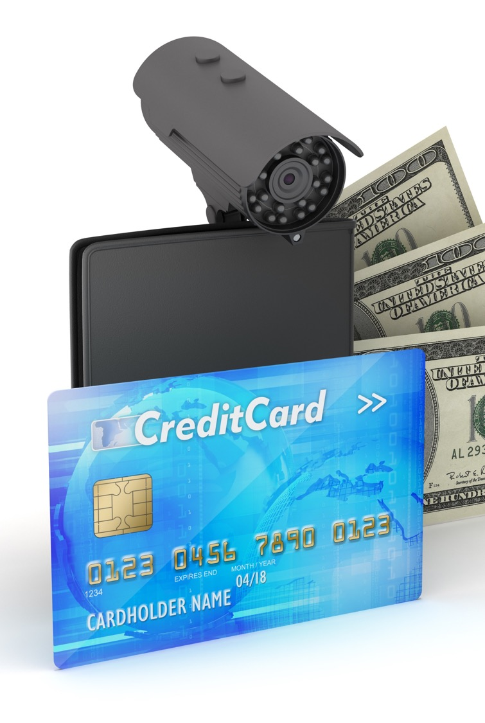
L.O.C. IT
Lock– Protect the devices you use to access your payment options: personal computers, mobile phones, tablets, etc.
Only You – Only you should have access sensitive information, safeguard sensitive data, including passwords, PINs, and answers to security questions.
Call – Before anything happens, know who to call if there are issues.
Notes:
Lock It Down – Protect (physically and with passwords/passphrases) the devices you use to access your payment options: personal computers, mobile phones, tablets, etc.
Only You – Only you should have access sensitive information, safeguard sensitive data, including passwords, PINs, and answers to security questions.
Know Who to Call – Before anything happens, know who to call if there are issues.

Slide 66
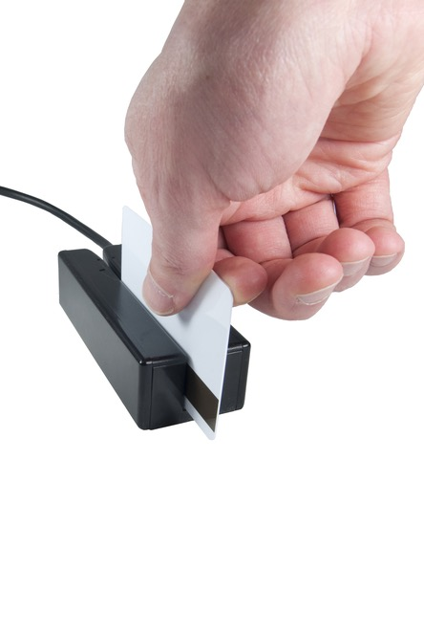
Skimming
What is Skimming?
It is where someone runs your card through a device that captures all of its data. That information may then be used to create a fake card with your information. They use the fake card and you get the bill.
How do you avoid skimming?
Don’t let your card out of your sight.
Don’t use an ATM or other machine that looks like it has been tampered

Slide 67
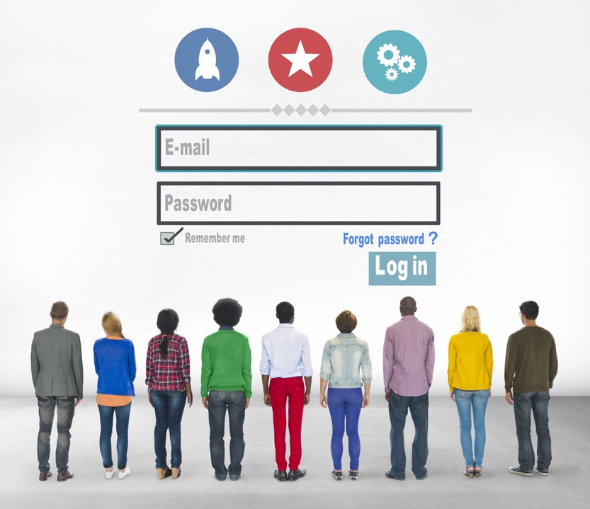
Preventing Fraud Online
From spyware to shady merchants, the threat of online fraud is real, but you are the best line of defense. The key to combating online fraud is knowing what threats exist and taking easy steps to beat them.

Slide 68
Create Strong Passwords
Use Different Passwords Everywhere
Don’t use kids, pets, favorite teams etc.
Ignore emails from unfamiliar sender
Software & Virus Protection
Firewall protection and spam filtering
Notes:
Computer software used to be static, and updates were few and far between. Now frequent updates are routine--and critical. Ignoring the latest updates can have serious consequences.
Antivirus products distinguish themselves by going beyond the basics of on-demand scanning and real-time protection. Some rate URLs that you visit or that show up in search results, using a red-yellow-green color coding system. Some actively block processes on your system from connecting with known malware-hosting URLs, or with fraudulent (phishing) pages.
Remember the Underwear Meme:
Passwords are like underwear. You should change them often, Don't share them, Don't leave them out for others to see (no sticky notes!). Wait, sorry, I mean they should be mysterious. In other words, make your password a total mystery to others.
If the word you use can be found in the dictionary, it's not a strong password. If you use numbers or letters in the order they appear on the keyboard ("1234" or "qwerty"), it's not a strong password. If it's the name of your relatives, your kids, or your pet, favorite team, or city of your birth, guess what—it's not a strong password. If it's your birthday, anniversary, date of graduation, even your car license plate number, it's not a strong password. It doesn't matter if you follow this with another number. These are all things hackers would try first. They write programs to check these kinds of passwords first, in fact.
Other terms to avoid: "god," "money," "love," "monkey," "letmein," and for the love of all that's techie, if you use "password" as your password, just sign off the Internet right now.

Slide 69
Beware of Downloading files
Avoid Public Wi-Fi
Monitor Your E-Statements
Delete your statements
Sign up for email/text “transaction alerts” from your bank
Notes:
Don’t let fraud ruin the trip of a lifetime. Take these few easy measures before you leave.

Slide 70
More on Passwords
To create a strong password, you should use a string of text that mixes numbers, letters that are both lowercase and uppercase, and special characters.
1) Spell a word backwards.
(Example: Turn "New York" into "kroywen.")
2) Substitute numbers for certain letters.
(Example: Turn "kroywen" into "kr0yw3n.")
3) Randomly throw in some capital letters.
(Example: Turn "kr0yw3n" into "Kr0yw3n.")
4) Don't forget the special character.
(Example: Turn "Kr0yw3n" into "Kr0yw3^.")
Notes:
To create a strong password, you should use a string of text that mixes numbers, letters that are both lowercase and uppercase, and special characters.
It should be eight characters, preferably many more. A lot more. The characters should be random, and not follow from words, alphabetically, or from your keyboard layout.

Slide 71
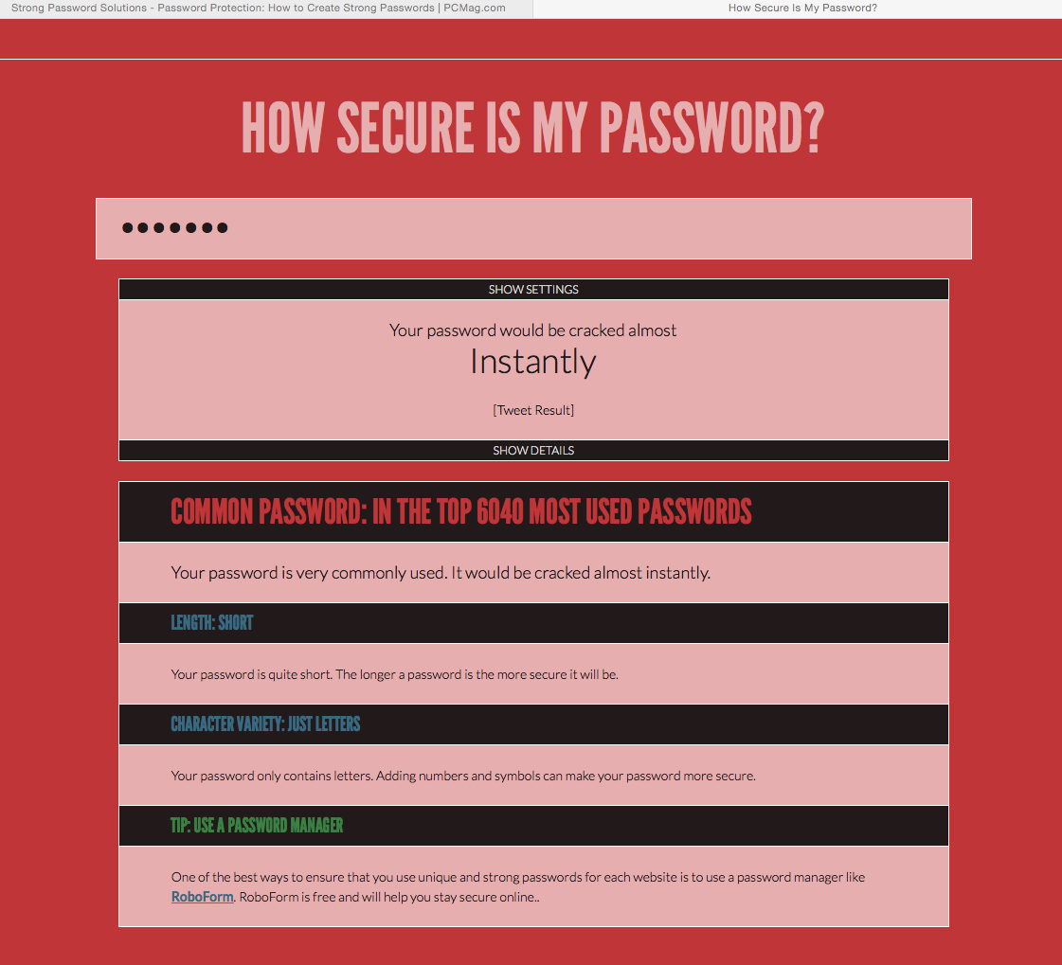
howsecureismypassword.net

Slide 72
The Chip aka…

Slide 73
EMV
What is EMV?
Why do chip cards matter?
But do they really work?
Who takes the chip?
Notes:
EMV isn’t a specific type of debit or credit card; it’s a standard. EMV stands for Europay, MasterCard, and Visa. In the 90s, these three organizations realized there was a need for more secure payment technology—and that it had to be global. So, they got together and wrote the first version of the EMV standard, which was published in 1996. Since then, Discover, American Express, JCB, and UnionPay have all joined the original founders (creating EMVco*). Together, this group maintains and improves the EMV standard.
Cards that adhere to the EMV standard have a chip that stores the card information. When you use your card, software on the chip can interact with the merchant’s card reader to create a unique authorization code for each purchase.
Why do chip cards matter?
Chip cards are virtually impossible to duplicate. Therefore, they can prevent one of the most prevalent types of fraud: counterfeit-card fraud. This type of fraud occurs when card information is stolen, either by skimming (swiping the card through a device designed to illegally capture it) or hacking, and then used to create counterfeit cards.
But do they really work?
Chip cards are undoubtedly effective: Europe has seen a 70% reduction in counterfeit card fraud with the introduction of EMV technology.1
Chip cards increase card security—but they aren’t a silver bullet. They’re designed to prevent fraud that occurs with a duplicate card. Card networks are still exploring technologies designed to prevent other types of fraud.
How do stores decide?
The switch to chip cards is already underway. It’s a mind-blowingly huge task—there are about 1.2 billion cards to replace, and merchants will have to update about 12 million card readers.2 This is part of the reason why the U.S. has been, arguably, slow to adopt this technology.
Some banks are already sending out chip cards, either in batches or as cards expire. Other banks are on the verge of rolling them out to customers. According to a recent study by the debit network PULSE, an estimated 25% of the debit cards in the U.S. will have chips by the end of 2015. Since it takes a lot of time to manufacture and mail new cards, the remaining 75% may take months or even years. PULSE estimates that 96% of debit cards will have chips by the end of 2017.3 As each new card is issued and each card reader is updated, the entire payment network becomes more secure.

Slide 74
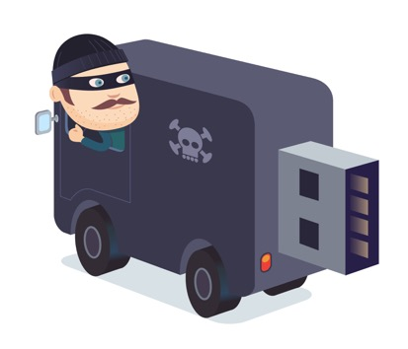
Identity Theft
Revisit/ Inactive Accounts
Shred Sensitive Documents
Sign New Cards
Notes:
USBs and other storage devises
Monitor card and account statements frequently
Report missing cards immediately
Cancel all inactive accounts
Do not volunteer any personal information unless necessary
Sign new cards upon receipt
Shred sensitive documents before disposing of them
Install anti-virus and anti-spyware software
Change passwords regularly

Slide 75
@Home
Did you know that half of all identity theft is committed by individuals with legitimate access to your home such as live-in caregivers, friends of relatives, renovation crews etc.?

Slide 76
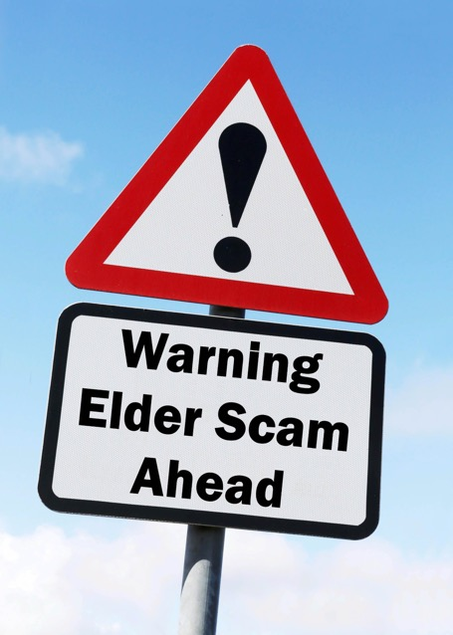
Avoid Deceptive Marketing
Have you ever signed up for what you thought was a "free trial" then found out months later you’ve been getting billed for it each month?
Read and understand all terms and conditions
Beware of any “free trial” that requires a payment card number
Understand all pre-checked boxes when ordering online
Review statements for unauthorized or unusual activity
Try to resolve issues with the merchant first; if unsuccessful, contact your financial institution
Notes:
Have you ever signed up for what you thought was a "free trial" then found out months later you’ve been getting billed for it each month? Marketers sometimes offer a free trial or free product but may not adequately convey that you needed to “opt-out” before the end of the trial period to avoid a recurring monthly charge.
Read and understand all terms and conditions
Beware of any “free trial” that requires a payment card number
Understand all pre-checked boxes when ordering online
Review statements for unauthorized or unusual activity
Try to resolve issues with the merchant first; if unsuccessful, contact your financial institution

Slide 77
Dumpster Diving Fraud
Fraudsters may go through your trash trying to find documents they can commit fraud with such as voided checks, credit card offers, bank statements, etc.
Avoid being subject to this kind of fraud by shredding any documents with sensitive financial information about you prior to placing it in the trash.
Housing Departments/TDHEs can offer a shredding day or booth at Tribal Events

Slide 78
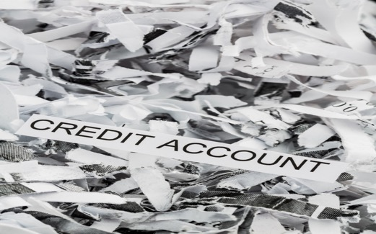
Mail & Phone
Beware of notices announcing that you’ve won a prize for a contest you did not enter
Notify your post office if you change address
Make sure your mailbox is secure
Have your mail held when on vacation
Collect your delivered mail; don’t let it sit in the mailbox too long
Notes:
Fraudsters can send official-looking letters or pose as representatives from Visa, financial institutions or even charities. If asked to provide your account number or other personal information in the mail or by phone, be wary of fraud.

Slide 79
Identity Theft Action Steps
If you take action quickly, you can stop an identity thief from doing more damage.
Follow these three steps as soon as possible:
Place an Initial Fraud Alert
Order Your Credit Report
Create an Identity Theft Report
Notes:
http://www.consumer.ftc.gov/articles/0274-immediate-steps-repair-identity-theft
Three nationwide credit reporting companies keep records of your credit history. If you think someone has
misused your personal or financial information, call 1 of the companies and ask them to put an initial fraud
alert on your credit report. You must provide proof of your identity. Equifax, Transunion, Experian

Slide 80
Order Your Credit Report
Equifax
1‑800‑525‑6285
Experian
1‑888‑397‑3742
TransUnion
1‑800‑680‑7289
Report that you are an identity theft victim.
Ask the company to put a fraud alert on your credit file.
Confirm that the company you call will contact the other 2 companies.
http://www.consumer.ftc.gov/features/feature-0014-identity-theft

Slide 81
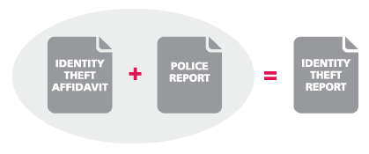
Create an Identity Theft Report
Submit a report about the theft to the FTC. When you finish writing all the details, print a copy of the report. It will be called an Identity Theft Affidavit.
Bring your FTC Identity Theft Affidavit when you file a police report.
File a police report about the identity theft, and get a copy of the police report or the report number. Your FTC Identity Theft Affidavit and your police report make an Identity Theft Report.

Slide 82
Housing is A market

Slide 83
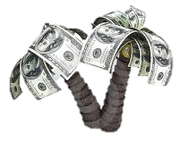
Renting Vs. Owning
RENT
BUY
VS.

Slide 84
Advantages
Forced savings plan because mortgage principal payments are retained as equity in the home
Usually a good long-term investment– home value can increase over time
Property taxes & interest payments can be deducted from your federal income taxes
Mortgage payments can be less than rent payments in some markets.

Slide 85
Advantages
As equity builds, you can step up to a larger home or borrow against your home (home equity loan) to make home improvements etc.
Homeownership can enhance a family's sense of control over their lives & environment, as well as promote stronger community ties . i.e. education, tribal events etc.
You can customize a home to suit stages of life, special needs, and personal tastes.

Slide 86
Disadvantages
Monthly payments may be higher than rent payments
You must pay for regular maintenance & periodic repairs
Owning is less flexible than renting; most first-time home buyers live in a home for 7 years
Like any investment, there is no guarantee that your home value will increase

Slide 87
Partners in the purchase
There are many people who will be assisting your family to purchase your new home.

Slide 88
The Buyers
The Buyer is the person or persons buying the home. They will need:
Income
Money Saved
Little to No Debts

Slide 89
The Sellers
The Sellers are the folks who will show proof they own the home and have the right to sell it.

Slide 90
The Helpers
Bank/Loan Officers
They help people borrow money from a bank to buy a home.
Sales Agent/REALTORS®
They help the buyers find a home within their budget.
They help the sellers. They place signs out front and online letting everyone know the house is for sale.
Bank/Loan Underwriters
Think of them as someone who checks the loan officer’s homework. They check and verify that the buyer has income they can afford to payback the loan. They also check to make sure the buyers have been making money smart decisions.

Slide 91
Understanding Costs & Decision Making
With just the m&m’s in your hand create your perfect home.

Slide 92
The Helpers
Inspectors
The Buyers hire an inspector before buying a home, to tell them if the house needs any repairs.
Appraisers
Remember Value? Appraisers check to make sure the new home is worth the same as the amount as the home loan.
Attorneys/Lawyers
Remember Money? Money is a Legal tender and can be exchanged for Goods and Services. Attorneys* review all the documents and make sure the exchange is made properly.

Slide 93
How Can You Help?
Help create a Family budget.
Saving money is important, especially when buying a new home.
Ask questions. You have professionals that can answer your real estate or financial wellness questions.
Planning. Plan to paint your new room and save up for the paint or make a list/poster, so your family can see what you would like to have in your new home.
Be flexible. With that many helpers, there can be many plans or timelines that change unexpectedly.

Slide 94
Understanding Risk

Slide 95
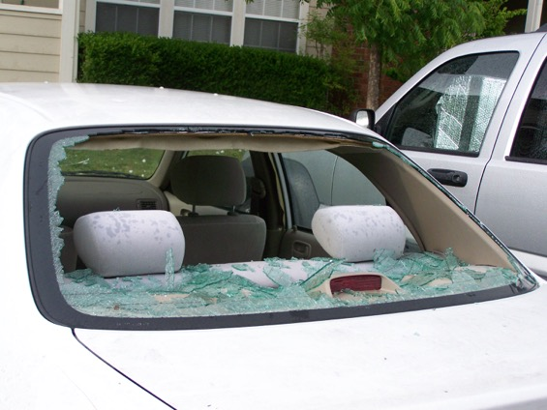
Four Minutes in Oklahoma…
Notes:
Between 5:00 and 5:30 CST on May 10, 2010, Oklahoma got hit with 32 tornadoes that hit the entire state from north to south. I was at home, and an F4 tornado hurled the softball sized hail you see in the picture here. That looks like a piece of styrofoam, but it’s a real hailstone. In the space of 4 minutes, that tornado totaled my car, causing the damage you see on the right. The cars parked on each side of my car were left untouched by the tornado. I was prepared! I had good car insurance, and my boss let me work from home until I could get another car.

Slide 96
Renters Insurance
If you experience a covered loss in your rented space, renter’s insurance can help to cover the associated costs. The amount covered will depend on the type of loss that occurred and the amount of coverage you have.
There are two types of coverage options under a typical renter’s policy:
Actual Cash Value coverage and Replacement Cost coverage.
Actual Cash Value coverage will reimburse you for the value of the items at the time of the damage or loss.
Replacement Cost coverage covers the cost it takes to replace the items lost or damaged.

Slide 97
What does renters insurance cover?
A renters insurance policy offers you coverage for the loss or destruction of your personal belongings in the event of a covered peril such as:
Fire
Lightning
Windstorm
Hail
A frozen plumbing system
Theft
Vandalism
Impact by a vehicle

Slide 98
Renters insurance may also cover you if:
You are forced to temporarily move out of your home: In the event your home becomes unlivable due to damage caused by a covered instance such as a fire or vandalism, renters insurance can help cover the cost of alternative living arrangements while your home is repaired or rebuilt.
A person is injured on your property and requires medical attention: Personal liability coverage is designed to protect you, as well as other individuals who visit your home, if an accident were to occur. This type of coverage will help pay for medical costs and legal fees that you could end up incurring.
Items you keep inside your car are damaged or lost: Depending on your renters insurance policy, you may be covered for belongings that you keep inside your car. Note that this coverage does not include equipment or systems installed in the car.

Slide 99
Insurance
Health: can cover doctors visits and co pays to just hospitalization
Life: to help your family after you die; should help with the lost income of the insured
Auto: required by law; helps when a car is severely damaged
Homeowners: protects against natural disasters, fires, or someone who is injured at your home
Renters: protects the items inside the house
Product: on a specific purchase

Slide 100
Seasonal Home Repair Budget
Roof, appliances, cooling, plumbing, and electrical systems are costly to replace if regular maintenance is not provided.
Notes:
Almost every part of your home has a life and it can be extended or shorten depending on the amount of care.

Slide 101
Regular Maintenance List By Season
Notes:
Regular maintenance of equipment and fixtures will prevent the need for more costly repairs or replacement in the future.
Knowing your home means knowing your appliance and major systems needs.
Manufacturers’ warranties typically provide you with information to care for your
appliances and systems.

Slide 102
Schedule Home Maintenance
Summer: Roofing, painting, fencing, windows, doors, driveway

Slide 103
Home Maintenance
Fall: Insulate pipes, gutter check, heating system check

Slide 104
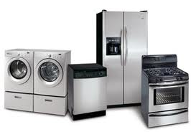
Home Maintenance
Winter: Indoor remodeling, countertop repair, appliance maintenance

Slide 105
Home Maintenance
Spring: cleaning & housekeeping, landscaping, repairing winter damage

Slide 106
Thank You.

